Slide 1

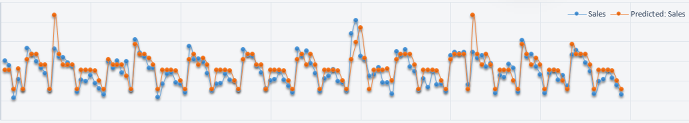
BMAN60422 Data Analytics for Business Decision Making
Coursework Project 2023/24: Prediction of Sales

Slide 2
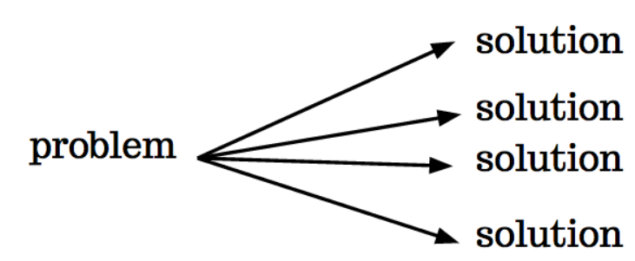
A few highlights
  NO standard solution for data analytics.
  Your choices of software tools and/or programming languages, often combination of them for the coursework project (SAS – NOT compulsory).
  Post your questions on the coursework Padlet! - https://manchester.padlet.org/mzyssyc2/bman60422-data-analytics-coursework-clnbaggwylvqgw6m (Password “data”)
  Support available in the following weeks during lab sessions, office hours, etc.
Notes:
Don’t have to follow …

Slide 3
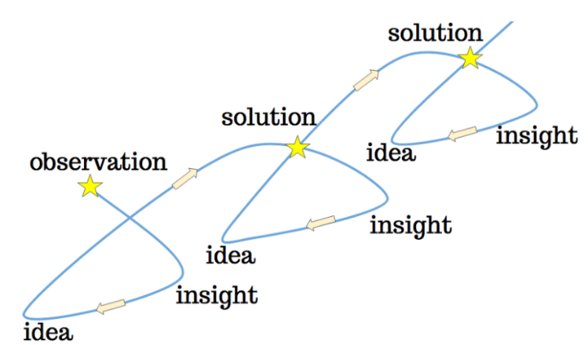
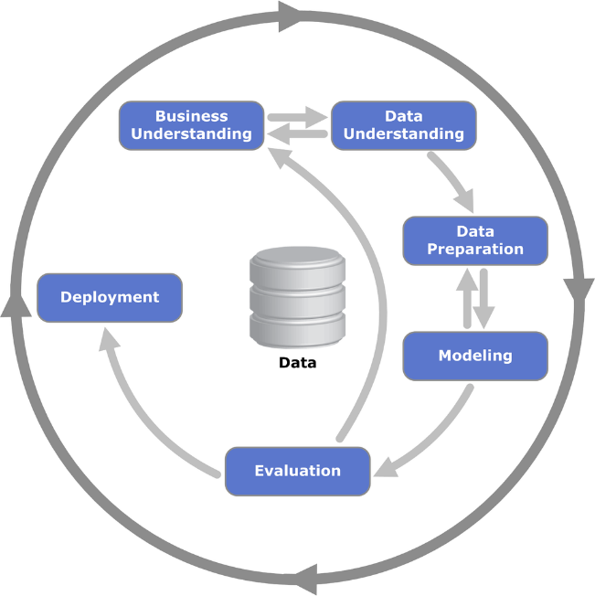
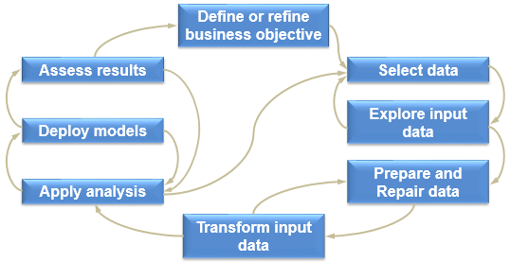
A few highlights
  Analytical methodology and cross-industry standard process for data mining (CRISP-DM) can be used to guide the process (NOT a linear process).
  Key objective: apply data analytics to inform decision making and achieve business values (selling points).

Slide 4
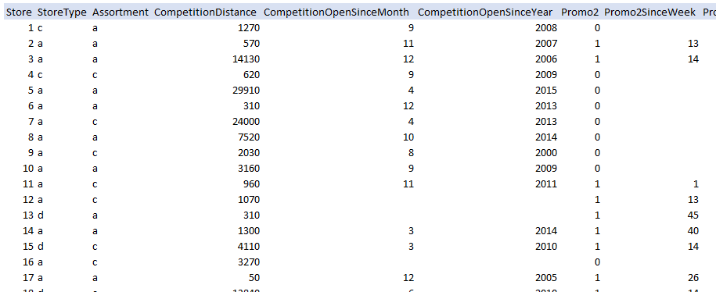
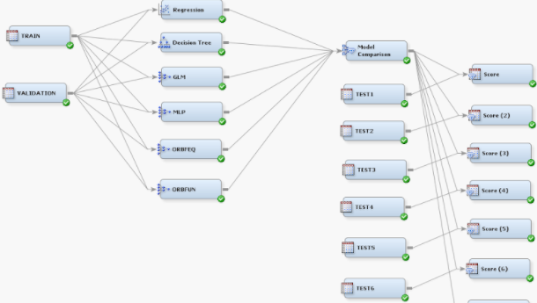
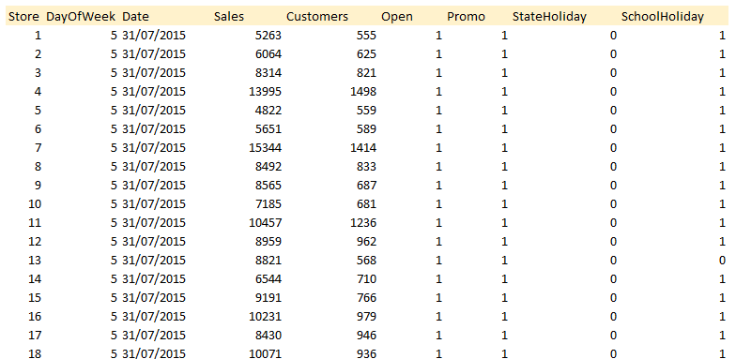
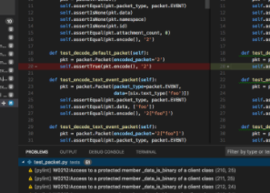
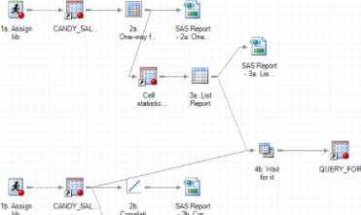
Prediction of sales is challenging
Objective
  Forecasting the 6 weeks of daily sales for 1,115 stores
  More reliable sales prediction → Increasing Profitability & Productivity
Forecasting accurately as possible
Understand the dataset fully
  store type & assortment
  competition distance ?
  competition opensince ?
  promo2 ?
  Excel
  SAS Miner
  Workstation
  store.csv
  Explore data, clustering, visualise
  Modelling, prediction
…
  dayofweek ?
  open?
  promo?
  holidays?
  customers?
  SAS Enterprise
  Guide
  Python/R?
  train.csv
  Extract time series historical data
  Figuring out influential input variables
…

Slide 5
Data preparation & pre-processing to predictive modelling
Activity
Data set
Target of Consideration
Data preparation
Pre- processing
Trans-
form
data?
such as
Duration
1
942
Define
clusters of stores
(typical
sales
patterns)?
No
Missing records
Partition data?
758
Impute
Data?
Have
Missing records
Restore
Competition
Promo2
Predictive modelling
Forecasting sales
Training
Partition
data
for
validation?
2
01/01/13 ~ 19/06/15
Explore
Input
variables
x n
Clusters
Iterative
Prediction
Predictive modelling
Validation
20/06/15 ~ 31/07/15
…
Predicted
Sales
Test
Data type
01/08/15 ~ 17/09/15
Time series

Slide 6
Data pre-processing and clustering of stores
Preparing
Restoring
Clustering/Scenario Analysis
store.csv
Combined
data
942
records
Cluster 1
Cluster …
train.csv
Cluster …
758
records
Imputed
758?
Cluster …
Cluster …
Historical
data
942 records
  131H
  132H
  141H
  142H
  151H
  Transformation into durations, e.g.,
    Competition open since month and year
    Promo2 since week and year
758 records
  Historical data

Slide 7
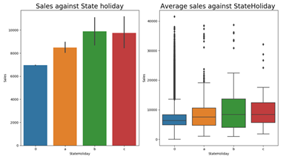
Predictive modelling and validation
2.2
  Predictive modelling methods and Tools used
Preparation for Modelling
  Predictive Modelling
Explore
Input
Variables
  Working on each cluster, separately…
  Decision tree
  Neural networks
  Multiple linear regression
  Advanced predictive models…
  Data type of input variable
    Nominal, Binary, Interval, …
  ANOVA, Box Plot, Correlation Analysis
  Time series
    Historical sales data (seasonal patterns)
    Added input variables (to capture seasonal…)
  Iterative prediction
Partition
Data
  train.csv
  test.csv
  training
  validation
  train.csv
  01/01/13
  20/06/15
  01/08/15
  17/09/15
  …
  same time period with test.csv
  being considered of weekly pattern, etc.
  01/08/15
  17/09/15
  14 or 7 days, etc

Slide 8
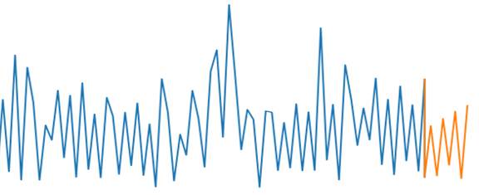
Make use of different predictors?
Consideration input variables
  Implication?
  Cluster¹⁾→
  1
  …
  …
  …
  …
  ↓ Input variables
1
  Store type B
    Distance of competitors
    Duration of competitor stores’ open days
    Promotion 2
  Store type B & Assortment B
    Duration of promotion 2
    Promo interval
    → more important than implementation of promotion
    …
  School holiday: seasonal patterns?
  BB
  Day of week
  Open
  State holiday
  Promo
2
  School holiday
3
1
  Compet. distance
  Compet. duration
  Promo 2
  Promo2 duration
2
  Promo interval
3
  Historical sales patterns
    1) Clusters in terms of ‘Store type’ & ‘Assortment’

Slide 9
Q & A

